Slide 1
Integrity check of Instruments as per hazardous area classification
Made by:
Divya Singh
NIT Jalandhar

Slide 2

Final Progress Review Presentation
Intern Name : Divya Singh
NIT Jalandhar
Instrumentation

Slide 3


Introduction
Name : Divya Singh
Institute: NIT Jalandhar
Dept : Instrumentation
Anchor/Co-Anchor: Mr. Arpit Shah
Personal & Educational background
UG College: NIT Jalandhar
Branch: Instrumentation and Control Engineering
Previous Internships: Winter Intern at Speedways Electric Company
Interests: Transducers , Control Systems
Photo of the Individual
Professional background and experience
Instrumentation and Electronics Department Head in Team Daksh , we have designed and fabricated autonomous electric solar car.
Instrumentation engineer intern at speedways electric company
Captain of NIT Jalandhar Athletics Club
Career Aspiration
Short term: To get placed in a reputed organization where I can enhance my skill set, gain knowledge & experience and use them for the success of organization.
Long term: To achieve a valuable leadership position and work for the success of organization by guiding and mentoring colleagues.

Slide 4
Internship Project – Executive Summary
Name : Divya Singh
Institute: NIT Jalandhar
Internship Start Date | 24/05/2022
Internship end Date | 24/07/2022
Project Title | Integrity Check of Instruments as per hazard area classification
Anchor | Mr. Arpit Shah
Co-Anchor / Guide | Mr. Rohit Ojha
Project Scope :
To study & understand hazardous area classification & protection techniques
To study & work on Hazardous Area & equipments used in it
To evaluate standard of Safety in the organization
To examine the safety procedures in maintenance & operations
Project Deliverables :
Appropriate installation of instruments according to hazard area classification
Hazardous Area Equipment register
Progress Update
Week 1: : HSE Induction, PPE, Access Card, Laptop Distribution & Plant Visit
Week 2: Project allotment and study of what is hazard , hazardous area classification requirement and approved standards for classification.
Week 3: Studied class/division and zone system of Hazardous Area classification
Week 4: Understood various protection techniques and methods and IP ratings
Week 5: Visited gas and oil well pads and understood the instruments installed there
Week 6: Visited RDG , RGT & bridge plant and understood the instruments
Week 7: Collected tag wise data and ratings of instruments installed as sample integrity check
Week 8: PPT Preparation and Internship Review
Key Challenges/Learnings
Learnings:
Process and working of plant
Hazardous Area & its related things
Applicable Safety Standards
Maintenance & Safety Practices
Insight of Plant Work & Culture
Challenges:
Two months time is less to cover instruments installed in all the fields

Slide 5
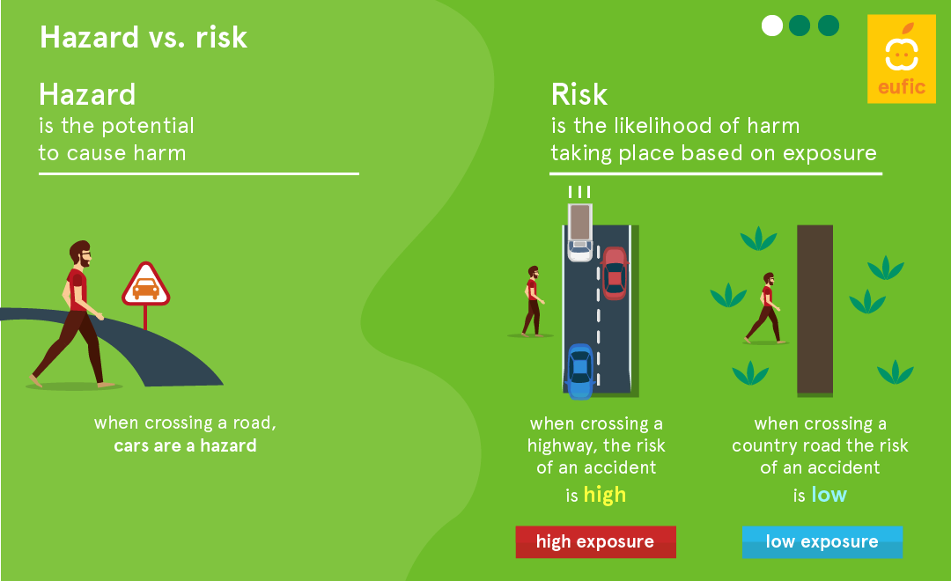
What is Hazardous Area
A place in which an explosive atmosphere may occur in such quantities as to require special precautions to protect the health and safety of the workers and equipment concerned is considered to be hazardous area.
Fire may occur in presence of 3 elements of the fire triangle as shown in figure.
An explosion may occur in presence of 6 elements of the explosion hexagon as shown in figure.
HAZARD vs RISK
Hazard
Risk

Slide 6
Hazardous Area classification requirement
Electrical and electronic equipment such as transmitters, circuit breakers, fuses, switches, relays, solenoids and resistors produce significant amounts of heat, arcing and sparking during normal and abnormal operation, which could pose a substantial risk of fire or explosion in facilities where chemicals are manufactured, processed or utilized.
To minimize the risk of fires or explosions that could result from this arcing, sparking and heat dissipation, it is critically important that electrical/ electronic equipment be designed, tested and labeled as being acceptable for use in the areas in which they are installed.
Protection methods are used to eliminate any one or more element from the fire triangle or explosion hexagon to avoid any fire, explosion .
The main advantage of Hazardous area classification are –
Selection of proper instrument capable to sustain in hazardous area
To reduce overall installation risk
To provide safe working environment
To provide required safety and mitigation method
To develop standard operating procedure

Slide 7
Approved Standards
For the Hazardous Area Classification, several standards, rules and regulations are followed. These standards are applied all over the world by approval agencies such as :
Approved Standards
TIIS
INMETRO
CUTR
NEPSI
CSA
IECEx
CML
FM
SAA
ATEX
CSA—Canadian Standards Association Baseefa
British Approvals Service for Electrical Equipment in Flammable Atmospheres
Approval accepted by Internationally
Baseefa—British Approvals Service for Electrical Equipment in Flammable Atmospheres
Approval accepted by European Union
Standards Association of Australia
Approval accepted by Australia
Factory Mutual
Approval accepted by North America
Certification Management Limited
Approval accepted by Japan
Canadian Standards Association
Approval accepted by North America
National Supervision and Inspection Centre for Explosion Protection and Safety of Instrumentation
Approval accepted by China
TIIS—Technology Institution of Industrial Safety
Approval accepted by Japan
INMETRO—National Institute of Metrology, Quality and Technology
Approval accepted by Brazil
FGUP Certification Centre: SC VSI VNIIFTRI Certification Body: OS VSI VNIFFTRI
Approval accepted by Russia, Belarus, Kazakhstan, and Armenia

Slide 8
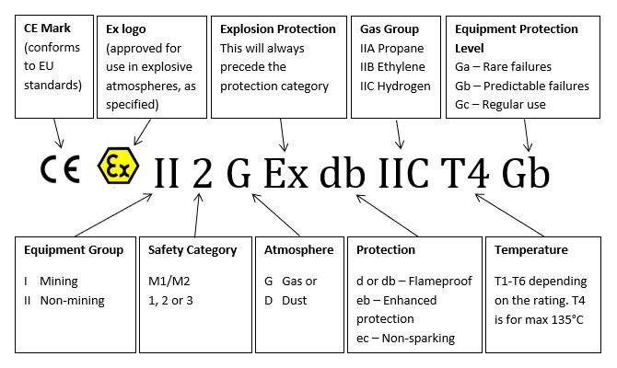
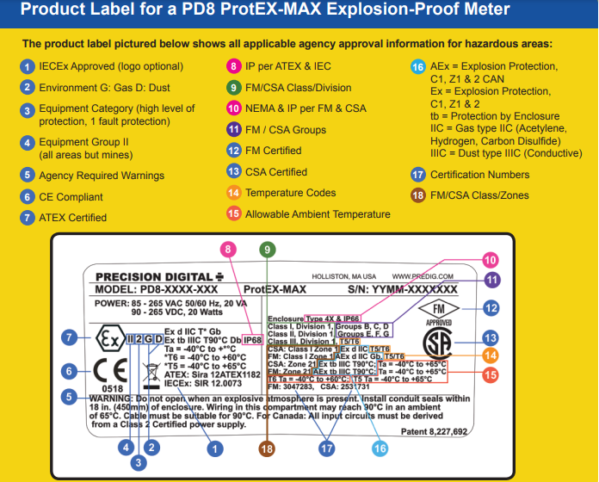
Approved Standards
In our Industry we refer to ATEX and IEC Standards.
Outside of North America, ATEX (Appareils destinés à être utilisés en ATmosphères EXplosives) and IEC (International Electrotechnical Commission) provide standards that are recognized internationally.
The major reasons for choosing a product certified through one organization over another are the location of the facility and the requirements of the local regulations.

Slide 9
Hazardous Area Classification
North American Classification
Hazardous Area Classification
Class/Division System
Zone System
Class
Division
Group
Class I
Class II
Class III
Division 1
Division 2
Group A
Group B
Group C
Group D
Group E
Group F
Group G
Zone
Group
Zone (Gas)
Zone (Dust)
Zone 0
Zone 1
Zone 2
Zone 20
Zone 21
Zone 22
Group I
Group II
Group III
Group IIA
Group IIB
Group IIC
Group IIIA
Group IIIB
Group IIIC
European & IEC Classification

Slide 10
CLASS / DIVISION SYSTEM
Hazardous Area Classification
The Class/Division system is used predominately in the United States and Canada. Hazardous locations as per the Class/Division system are classified according to the Class, Division, and Group.
CLASS
The Class defines the general nature (or properties) of the hazardous material in the surrounding atmosphere which may or may not be in sufficient quantities.
DIVISION
The Division defines the probability of the hazardous material being able to produce an explosive or ignitable mixture based upon its presence.
CLASS
Class I
Class II
Class III
Locations in which flammable gases or vapors may or may not be in sufficient quantities to produce explosive or ignitable mixtures.
Locations in which combustible dusts (either in suspension, intermittently, or periodically) may or may not be in sufficient quantities to produce explosive or ignitable mixtures.
Locations in which ignitable fibers may or may not be in sufficient quantities to produce explosive or ignitable mixtures.
DIVISION
Division 1
Division 2
Indicates that the hazardous material has a high probability of producing an explosive or ignitable mixture due to it being present continuously, intermittently, or periodically or from the equipment itself under normal operating conditions.
Indicates that the hazardous material has a low probability of producing an explosive or ignitable mixture and is present only during abnormal conditions for a short period of time.

Slide 11
CLASS / DIVISION SYSTEM
Hazardous Area Classification
GROUP
The Group defines the type of hazardous material in the surrounding atmosphere. Groups A, B, C, and D are for gases (Class I only) while groups E, F, and G are for dusts and flyings (Class II or III).
GROUP
Group A
Group B
Group C
Group D
Group E
Group F
Group G
Atmospheres containing acetylene.
Atmospheres containing a flammable gas, flammable liquid-produced vapor, or combustible liquid-produced vapor whose MESG (Maximum Experimental Safe Gap) is less than 0.45 mm or MIC ratio is less than 0.40. Typical gases include hydrogen, butadiene, ethylene oxide, propylene oxide, and acrolein.
Atmospheres containing a flammable gas, flammable liquid-produced vapor, or combustible liquid-produced vapor whose MESG is greater than 0.45 mm but less than or equal to 0.75 mm or MIC (minimum ignition current) ratio is greater than 0.40 but less than or equal to 0.80. Typical gases include ethyl either, ethylene, acetaldehyde, and cyclopropane.
Atmospheres containing a flammable gas, flammable liquid-produced vapor, or combustible liquid-produced vapor whose MESG is greater than 0.75 mm or MIC ration is greater than 0.80. Typical gases include acetone, ammonia, benzene, butane, ethanol, gasoline, methane, natural gas, naphtha, and propane.
Atmospheres containing combustible metal dusts such as aluminum, magnesium, and their commercial alloys.
Atmospheres containing combustible carbonaceous dusts with 8% or more trapped volatiles such as carbon black, coal, or coke dust.
Atmospheres containing combustible dusts not included in Group E or Group F. Typical dusts include flour, starch, grain, wood, plastic, and chemicals.

Slide 12
ZONE SYSTEM
Hazardous Area Classification
Zone system is followed by all over the world except United States and Canada. However, the United States and Canada are trending more towards the Zone System.
Hazardous locations per the Zone system are classified according to its Zone which can be gas or dust.
ZONE
The Zone defines the probability of the hazardous material, gas or dust, being present in sufficient quantities to produce explosive or ignitable mixtures.
Zone classification for Gas
Zone classification for Dust
ZONE
Zone 0
Zone 1
Zone 2
Ignitable concentrations of flammable gases or vapors which are present continuously or for long periods of time
Ignitable concentrations of flammable gases or vapors which are likely to occur under normal operating conditions
Ignitable concentrations of flammable gases or vapors which are not likely to occur under normal operating conditions and do so only for a short period of time.
ZONE
Zone 20
Zone 21
Zone 22
An area where combustible dusts or ignitable fibers and flyings are present continuously or for long periods of time.
An area where combustible dusts or ignitable fibers and flyings are likely to occur under normal operating conditions.
An area where combustible dusts or ignitable fibers and flyings are not likely to occur under normal operating conditions and do so only for a short period of time

Slide 13
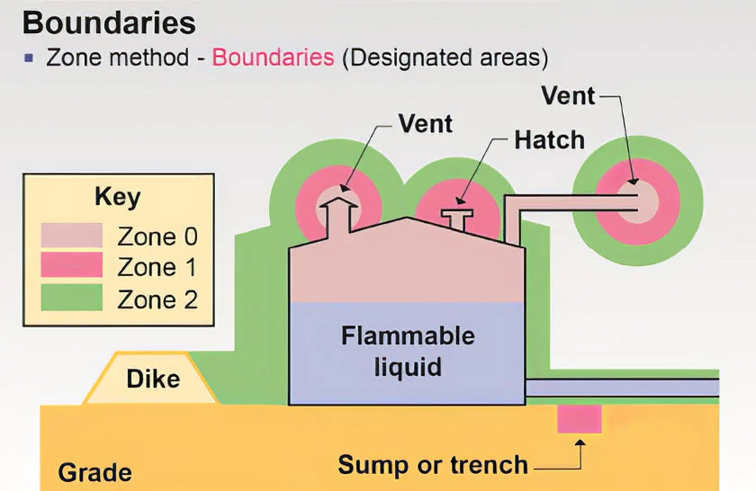
ZONE SYSTEM
Hazardous Area Classification
GROUP
Electrical equipment is divided into three groups-
Example of Hazardous area classification according to Zone system
Group
Group I
Group II
Group III
Equipment intended for use in mines susceptible to firedamp (flammable mixture of gases naturally occurring in a mine)
Equipment intended for use in places with an explosive gas atmosphere other than mines susceptible to firedamp. Group II equipment is subdivided into three subgroups
Equipment intended for use in places with an explosive dust atmosphere. Group III equipment is subdivided into three subgroups
Group IIIA—Atmospheres containing combustible flyings
Group IIIB—Atmospheres containing non-conductive dust
Group IIIC—Atmospheres containing conductive dust
Group IIA—Atmospheres containing propane, or gases and vapors of equivalent hazard
Group IIB—Atmospheres containing ethylene, or gases and vapors of equivalent hazard
Group IIC—Atmospheres containing acetylene or hydrogen, or gases and vapors of equivalent hazard

Slide 14
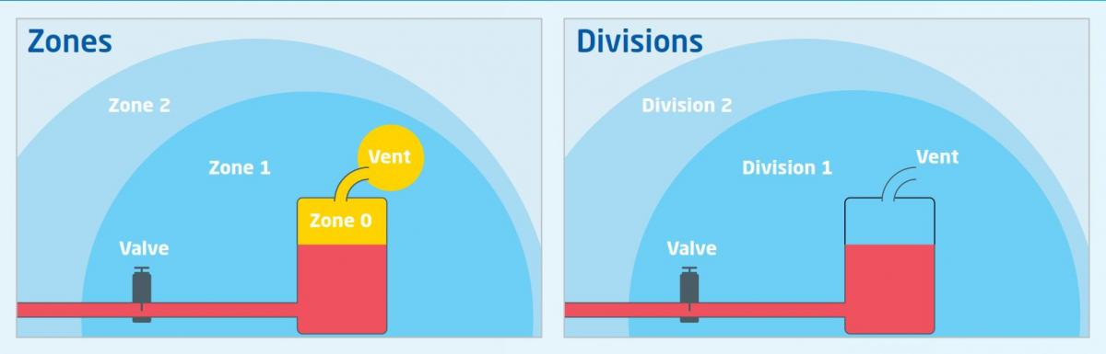
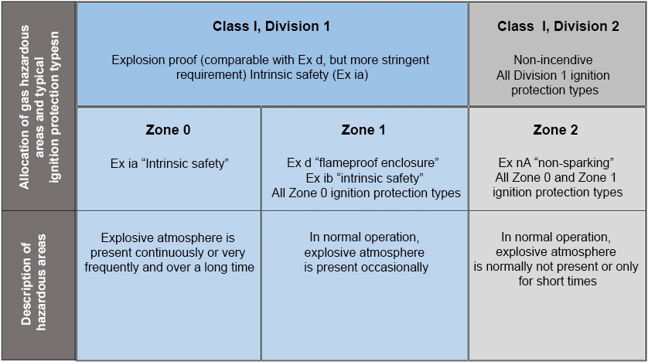
Comparison between Class/Division System and Zone System
Hazardous Area Classification

Slide 15
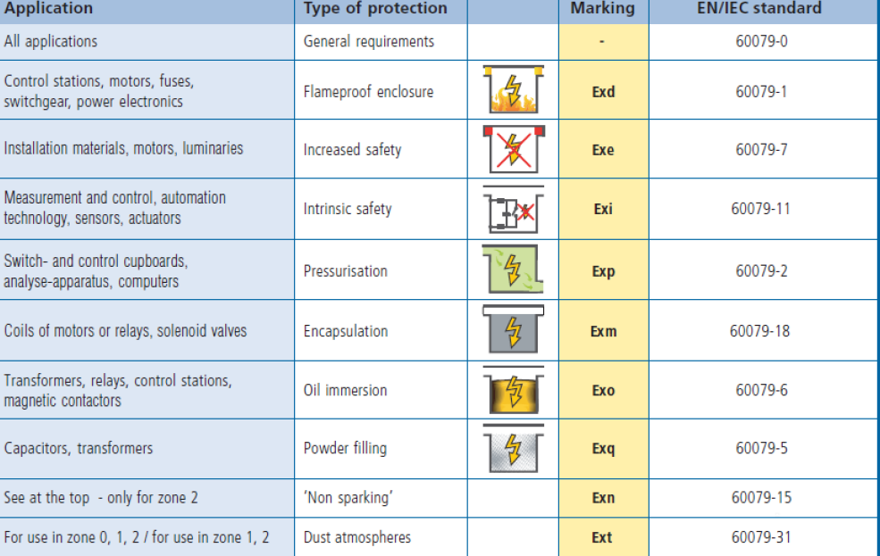
Protection Techniques and methods
In order to reduce the risk of explosion or fire from electrical equipment located in hazardous locations. , elimination of one or more of the components of the ignition triangle is necessary. There are three basic methods of protection—explosion containment, segregation and prevention.
Explosion containment:
The only method that allows the explosion to occur but confines it to a well-defined area, thus avoiding the propagation to the surrounding atmosphere. Explosion-proof enclosures are based on this method.
Segregation:
A method that attempts to physically separate or isolate the electrical parts or hot surfaces from the explosive mixture. This method includes various techniques, such as pressurization, encapsulation, etc.
Prevention:
A method that limits the energy, both electrical and thermal, to safe levels under both normal operation and fault conditions. Intrinsic safety is the most representative technique of this method.

Slide 16
Equipment Protection Level Making
The EPL marking indicates the level of protection that is given to equipment based on the likelihood of its becoming a source of ignition and distinguishing the difference between explosive gas atmospheres, explosive dust atmospheres, and the explosive atmospheres in mines susceptible to firedamp.
Gases
Ga
Gb
Gc
Equipment for explosive atmospheres due to the presence of gas, with 'very high’ level of protection, which is not a source of ignition in normal operation, or in case of expected failure or when subjected to a rare failure
Equipment for use in explosive atmospheres due to the presence of gas, with a 'high' level of protection that is not the source of ignition in normal operation or when subject to expected malfunctions, although not on a regular basis
Equipment for use in explosive atmospheres due to the presence of gas, with a level of protection ‘increased’ that is not a source of ignition in normal operation. It has some additional security measures in order to ensure that it remains a source of ignition not active in case of expected events on a regular basis (for example, the failure of a lamp).
Dusts
Da
Db
Dc
Equipment for explosive atmospheres due to the presence of combustible dust, which has a level of protection 'very high', and does not constitute a source of ignition in normal operation or when subject to rare failures.
Equipment for explosive atmospheres due to the presence of combustible dust, which has a level of protection 'high'. It does not constitute a source of ignition in normal operation or when subject to expected failures, although not on a regular basis
Equipment for explosive atmospheres due to the presence of dust, with a level of protection 'increased', which is not a source of ignition in normal operation. It may have additional protections in order to ensure that it remains inactive as a source of ignition in the case of regular and waited failure

Slide 17
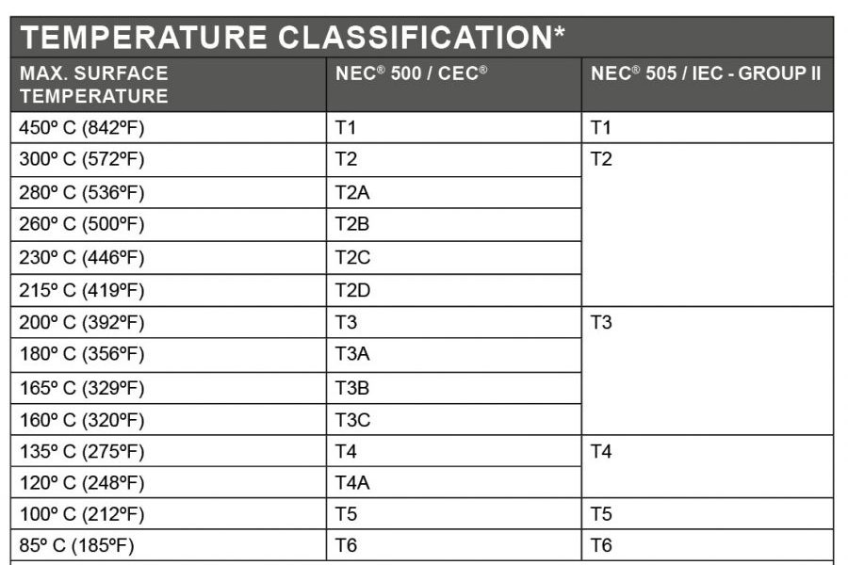
Temperature Code
A mixture of hazardous gases and air may ignite by coming into contact with a hot surface. The conditions under which a hot surface will ignite a gas depend on surface area, temperature, and the concentration of the gas present in atmosphere. The same can be said about combustible dusts. The T code of a product denotes the maximum surface temperature that a given product will not exceed under a specified ambient temperature. A list for Temperature code classification is shown.

Slide 18
IP (Ingress Protection) Rating
Ingress protection ratings or IP ratings, refer to the level of protection offered by an electrical enclosure, against solids and liquids.
IP ratings are defined by the international standard EN 60529 (British Standard BS EN 60529:1992)
This standard defines levels of sealing effectiveness against “ingress” i.e. intrusion from foreign bodies such as tools, dirt and liquid water.
The rating consists of the letters IP followed by two digits, the higher the number the better the protection. Sometimes a number is replaced by X , which indicates that the enclosure is not rated for that specification
IP65 = First Digit – Solids
The first digit indicates the level of protection that the enclosure provides against the ingress of solid foreign objects, from tools or fingers that could be hazardous if they came into contact with electrical conductors or moving parts, to airborne dirt and dust that could damage circuitry
IP65 = Second Digit – Liquids
The second digit defines the protection of the equipment inside the enclosure against various forms of moisture (drips, sprays, submersion etc )

Slide 19
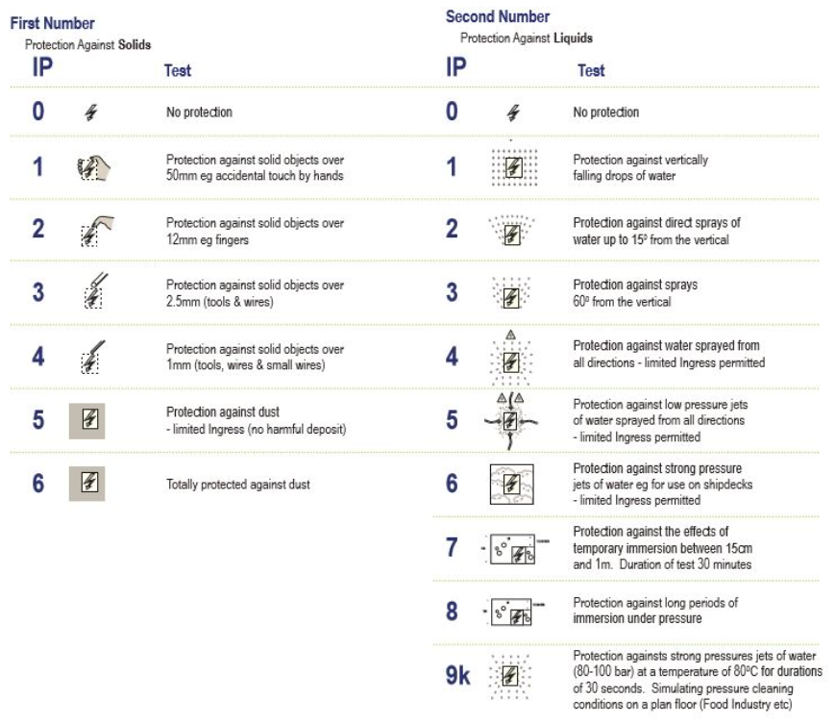
IP (Ingress Protection) Rating
Reference Chart

Slide 20
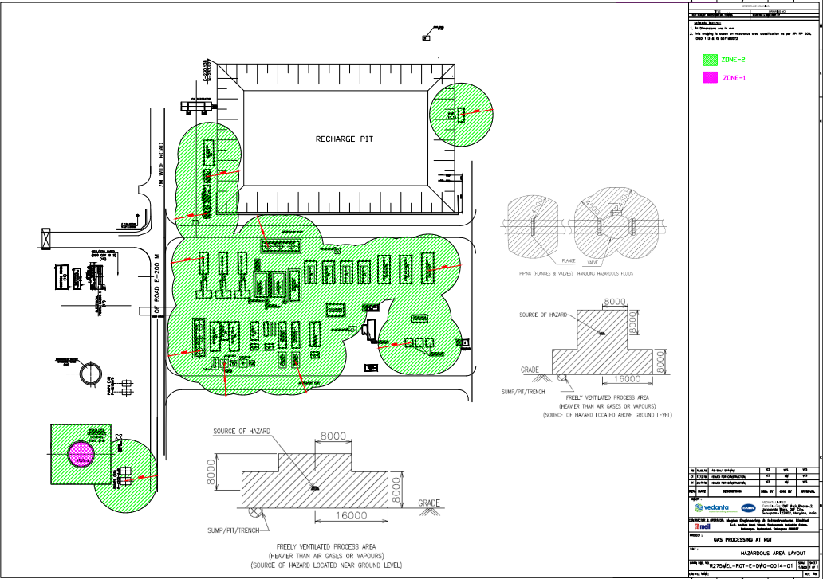
RGT & Bridge : Hazardous Area Classification Map

Slide 21
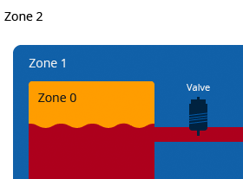
Areas under ZONE 2 in RGT & Bridge plant :
Stabilized Condensate Storage Tank (14) : (Area outside 1000m³)
Pumps (15) : P-4200-A/B ( Radius = 16000 )
Refrigeration Condensers Coolers Package Coolers (4)
LPS/UPS Skid-2 (6)
EG Skid -1/2 (9)
Heat Exchanger – 1/2
Glycol Drain Slump (17)
Stabilizer Tower (8)
Glycol Tank (27)
Methonal Day Tank (23)
Cond Stab CPE -1/2 : 2500 BPD (34)
CPE Cooler -1 (36)
Stab Skid with cooler & tower 5000 BPD (37)
Instrument Air Receiver – 3 (10 m³) : Base rind OD(outer diameter) 1780mm
NGL Coolers (7)
Cond. KOD
Hot Oil Package Foundation (10)
Export Gas Compressor -1/2/3 & cooler (29)
Refrigeration compressors skid-1/2 (3)
Refrigeration Vessel Skid (5)
Refrigeration Suction Scrubber (2)
Fuel Gas Skid (1)
Off gas compressor-1/2/3/4 (31)
Refrigeration Condensers coolers package
Instrument Air Receiver -2 (8 m³) : Base Ring OD 1560 mm
Export Gas Compressor – 1 (Temporary - 30)
Closed drain skid (28)
Unstabilised Cond. Buffer Vessel (21 & 22)
Storage Shed (20)
Sales Gas Filters
Chemical Injection (38)
Approach Way

Slide 22
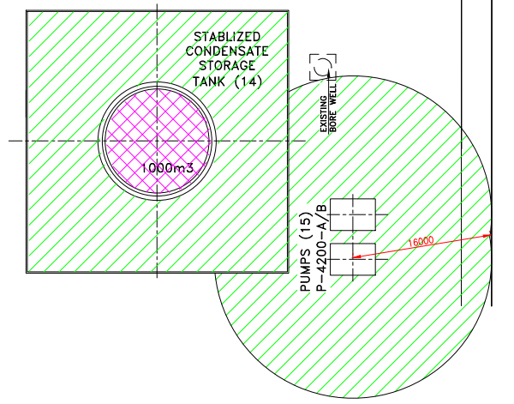
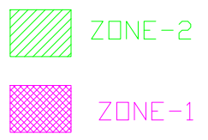
Areas under ZONE 1 in RGT & Bridge Plant :
Stabilized Condensate Storage Tank (14) : Inner Area of 1000 m³

Slide 23
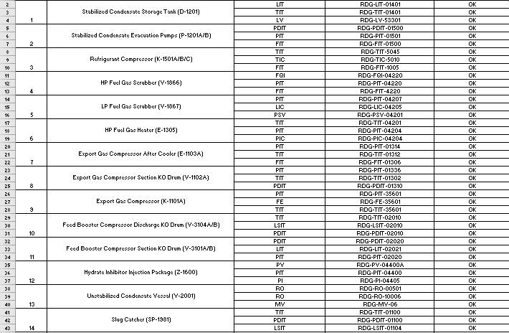
Data Collected

Slide 24
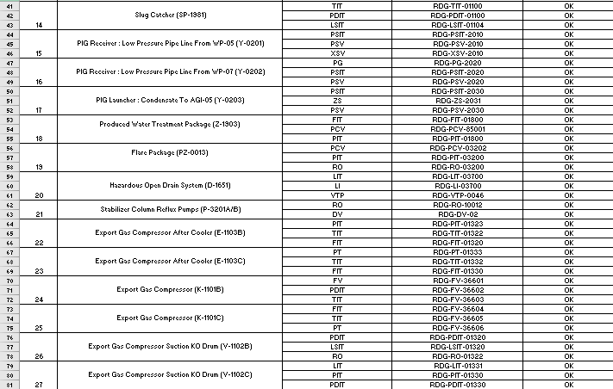

Slide 25
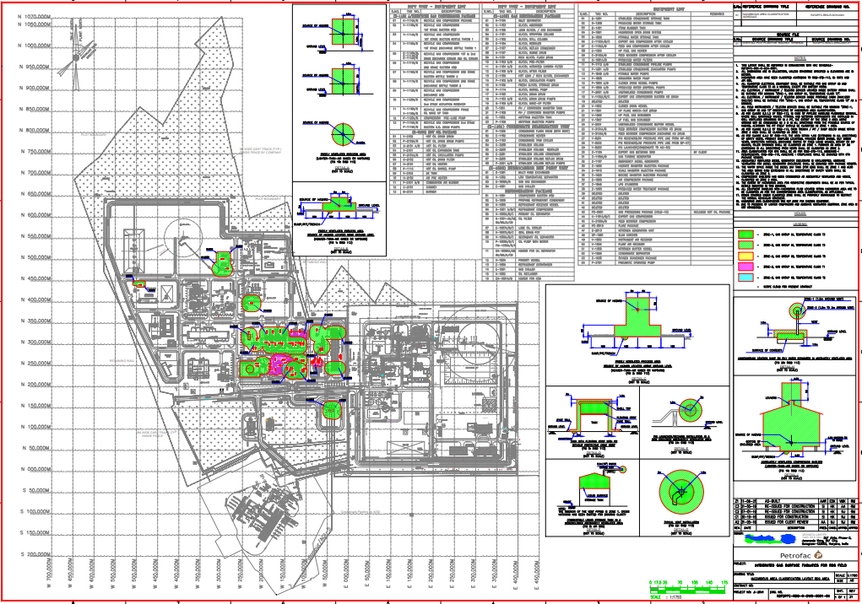
RDG : Hazardous Area Classification Map

Slide 26
Areas under ZONE 1 in RDG Plant :
Stabilized Condensate Storage Tank (14) : Inner Area of 1000 m³
Compressor Suction KOD (V-1501)
Refrigerant Receiver vessel (V-1503)
Refrigerant Compressor (K-1501A/B/C)
Gas Chiller (E-1501)
Propane Refrigerant Condenser (E-1505)
Gas Gas Exchanger (E-1509)
Multi Pass Exchanger (E-1301)
Recycle Gas Compressor : 1st Stage Suction KOD (V-1110A/B)
Recycle Gas Compressor : Discharge KOD (V1112-A/B)
Recycle Gas Compressor : 2nd Stage Suction KOD (V1111-A/B)
Recycle Gas Compressor : 1st and 2nd Stage discharge cooler and oil cooler (E-1110A)
Recycle Gas Compressor : 1st and 2nd Stage discharge cooler and oil cooler (E-1111B)
Feed Booster Compressor (K-3100A/B)
LO Cooler
LO Skid

Slide 27
Area under ZONE 2 in RDG Plant
Stabilized Condensate Storage Tank (D-1201)
Stabilized Condensate Evacuation Pumps (P-1201A/B)
Refrigerant Compressor (K-1501A/B/C)
HP Fuel Gas Scrubber (V-1866)
LP Fuel Gas Scrubber (V-1867)
HP Fuel Gas Heater (E-1305)
Export Gas Compressor After Cooler (E-1103A)
Export Gas Compressor Suction KO Drum (V-1102A)
Export Gas Compressor (K-1101A)
Feed Booster Compressor Discharge KO Drum (V-3104A/B)
Feed Booster Compressor Suction KO Drum (V-3101A/B)
Hydrate Inhibitor Injection Package (Z-1600)
Unstabilized Condensate Vessal (V-2001)
Slug Catcher (SP-1981)
PIG Receiver : Low Pressure Pipe Line From WP-05 (Y-0201)
PIG Receiver : Low Pressure Pipe Line From WP-07 (Y-0202)
PIG Launcher : Condensate To AGI-05 (Y-0203)
Produced Water Treatment Package (Z-1903)
Flare Package (PZ-0013)
Hazardous Open Drain System (D-1651)
Stabilizer Column Reflux Pumps (P-3201A/B)
Export Gas Compressor After Cooler (E-1103B)
Export Gas Compressor After Cooler (E-1103C)
Export Gas Compressor (K-1101B)
Export Gas Compressor (K-1101C)
Export Gas Compressor Suction KO Drum (V-1102B)
Export Gas Compressor Suction KO Drum (V-1102C)
27
27

Slide 28
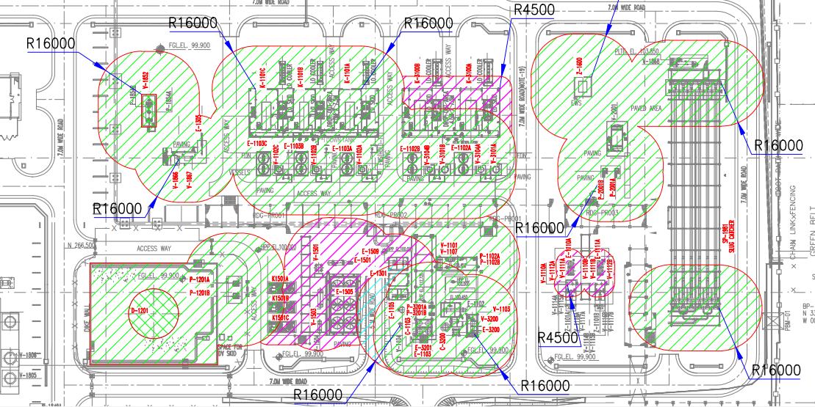

Slide 29
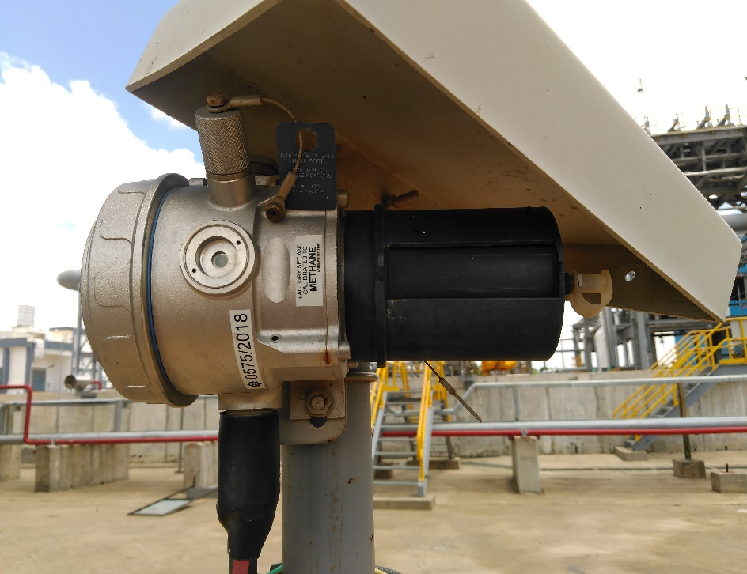
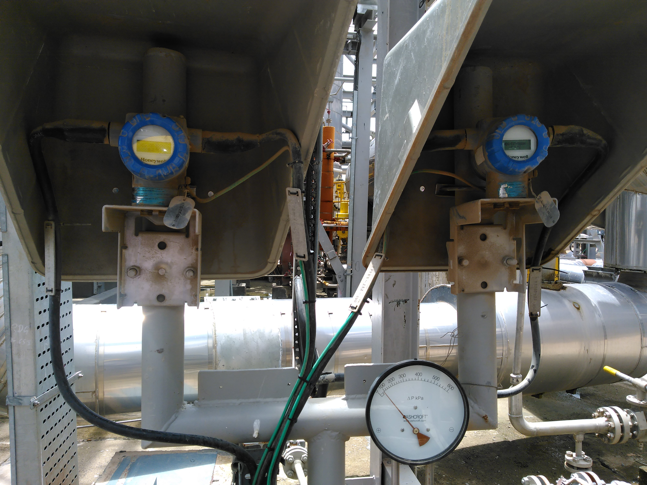
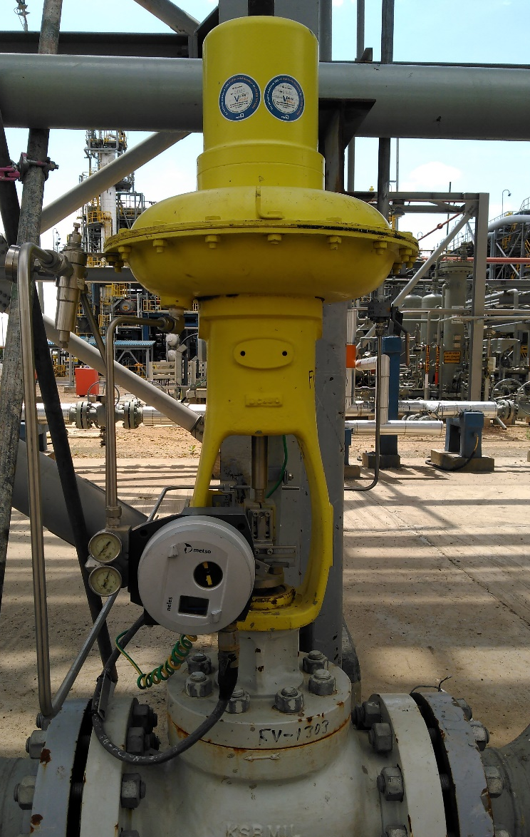
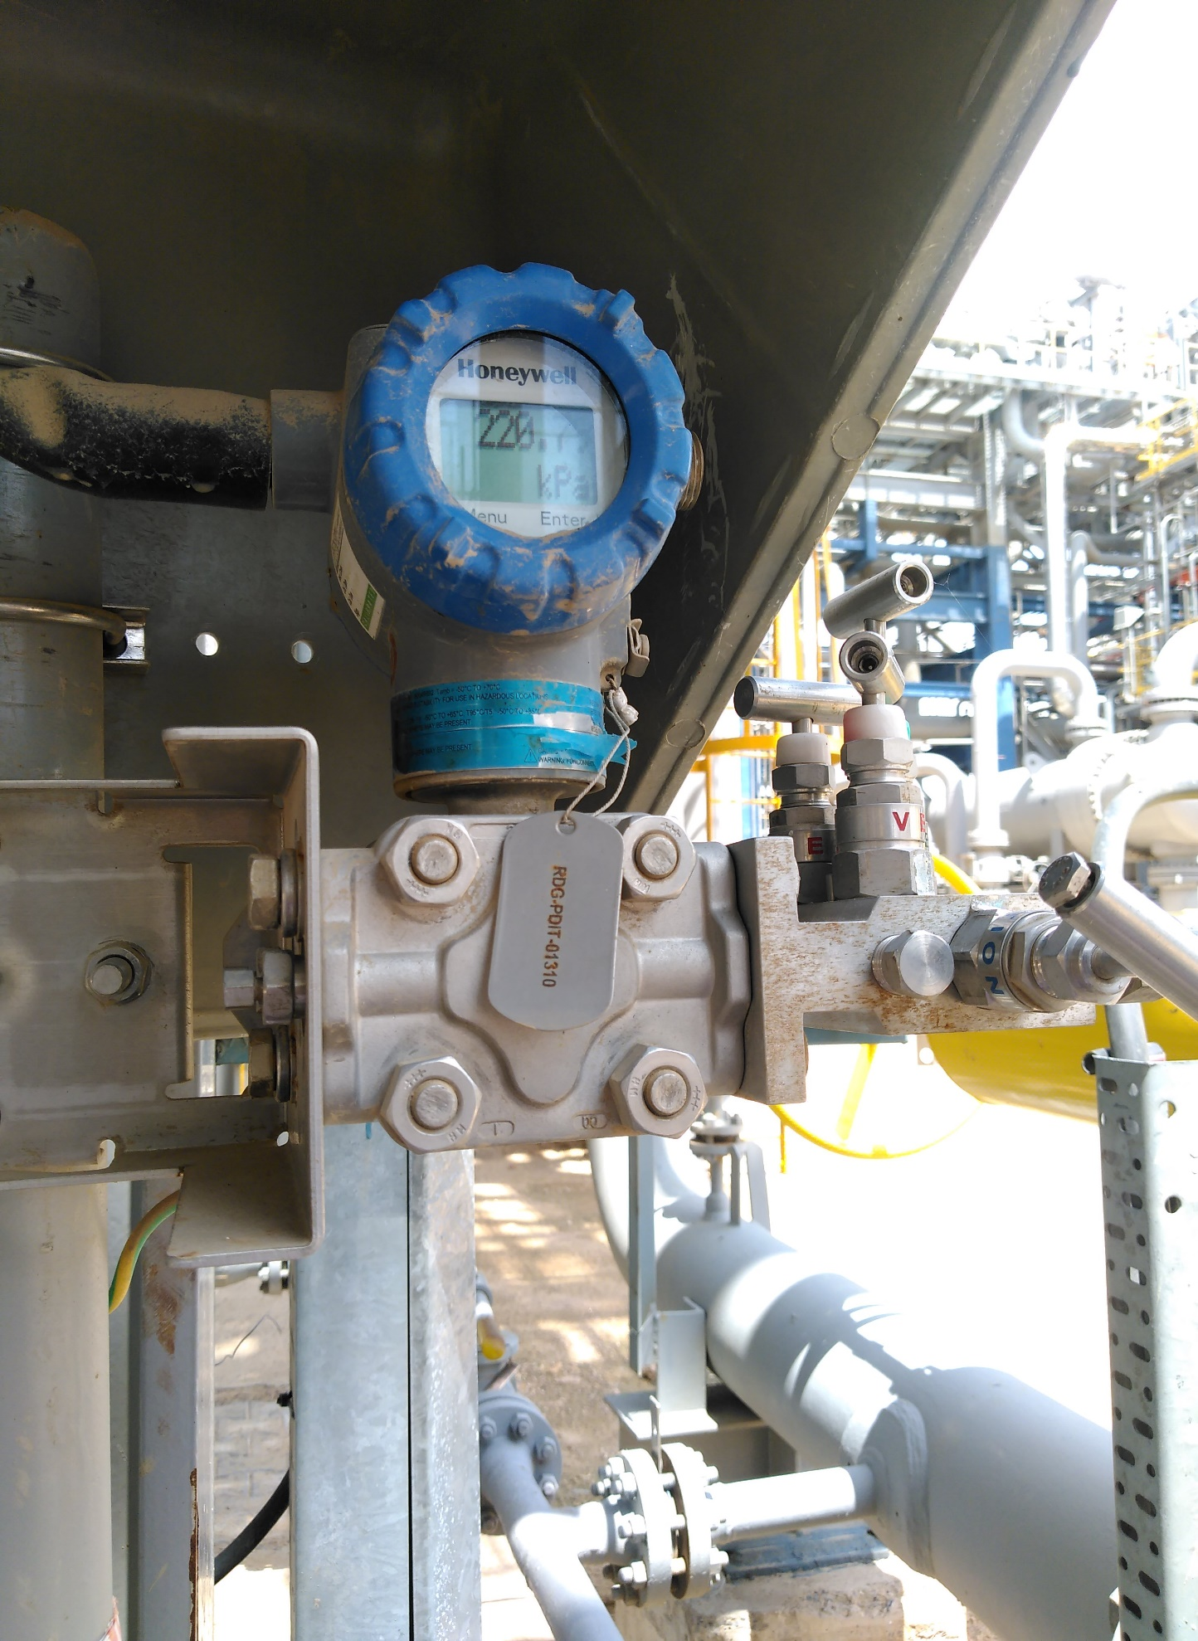
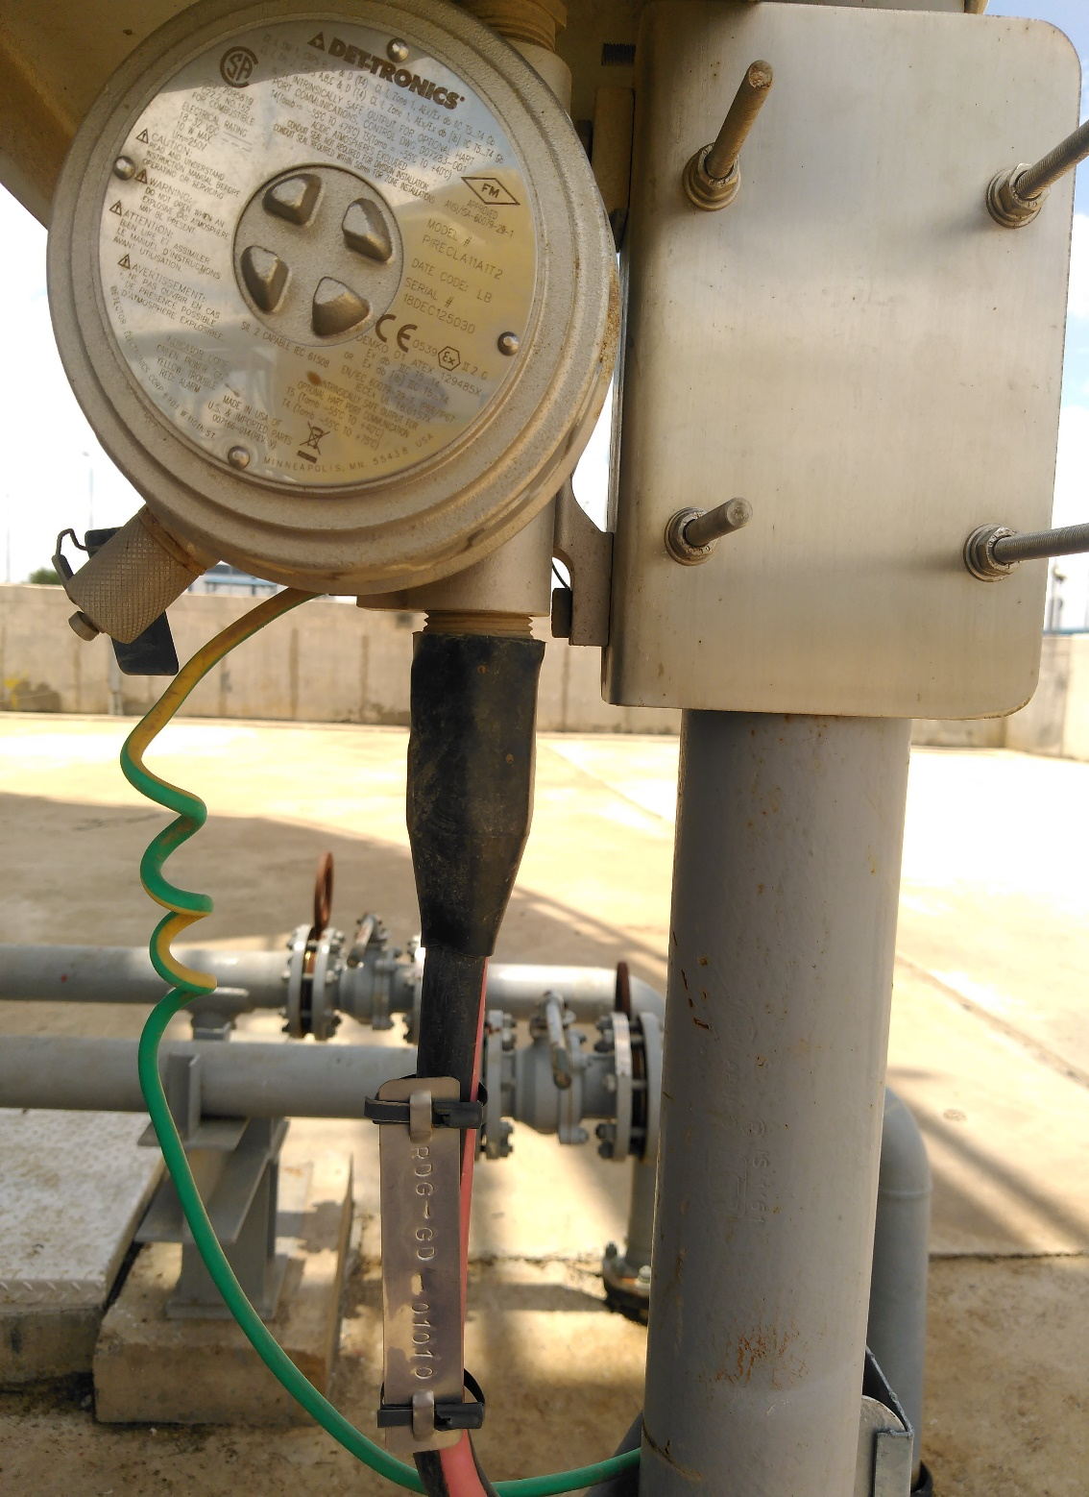
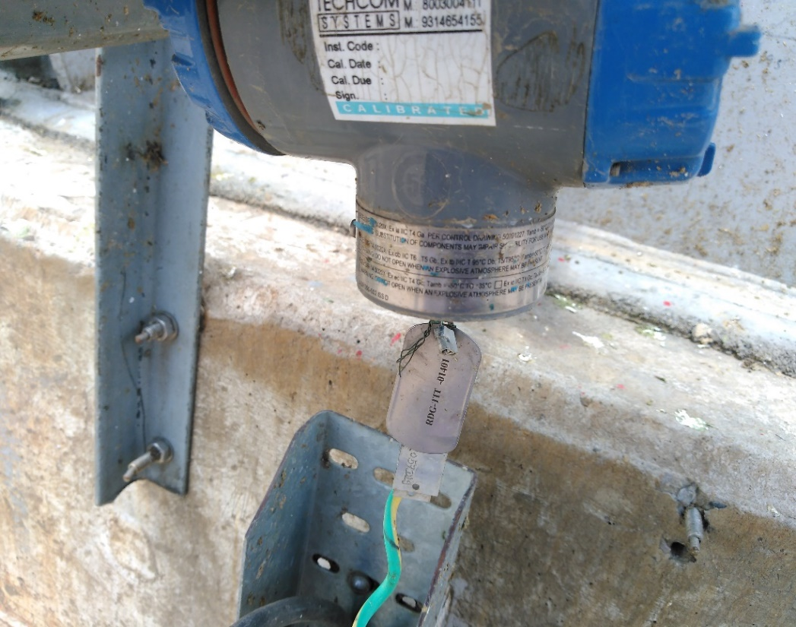
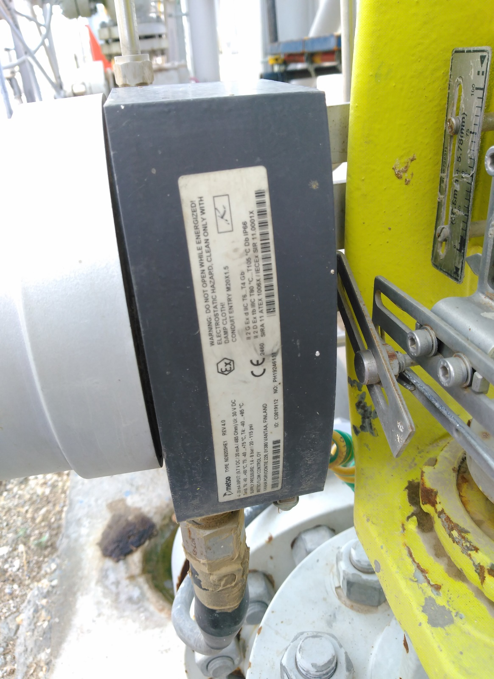

Instruments Ratings
Gas Detector (GD)
Cl I, Zone 1, AEx/Ex db IIC T5…Tb Gb
Intrinsically safe output
Temperature Indicator Transmitter (TIT)
Ex ec IIc T4 Gc Tamb=-50C to 135C
Flow Valve (FV)
II 2 G Ex d IIC T6…T4 Gb
II 2 D Ex tb IIIC T80C…T105C Db, IP66
Pressure Differential Indicator Transmitter (PDIT)
Ex d IIC T6 T5 Ga/Gb
Ex tb IIIC T95C Db

Slide 30
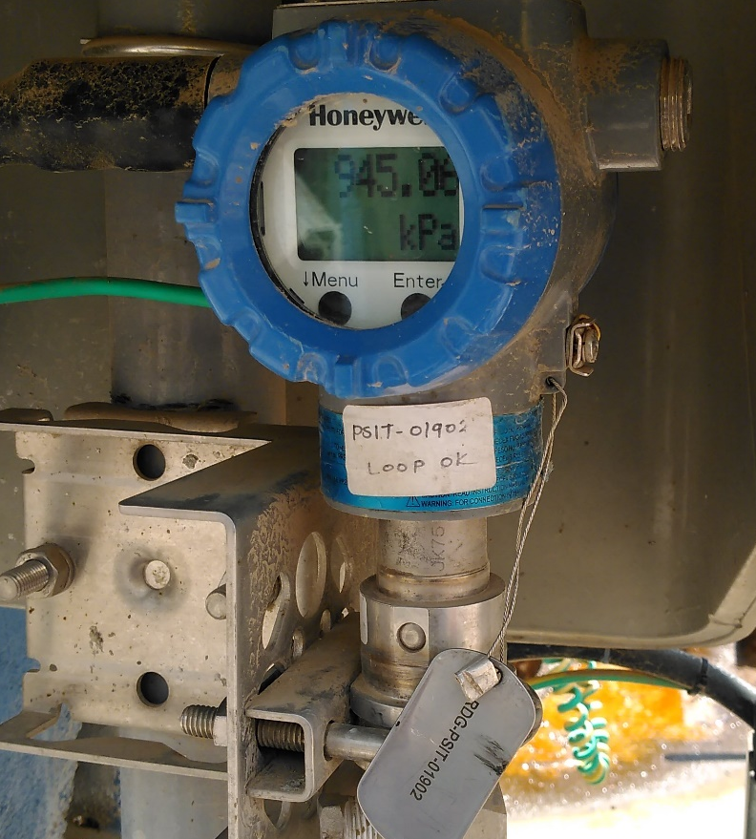
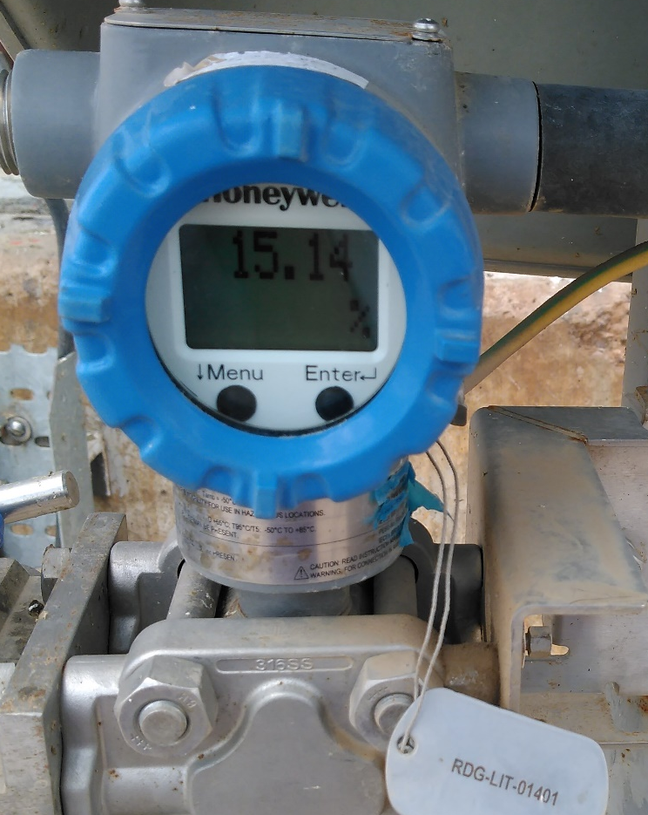
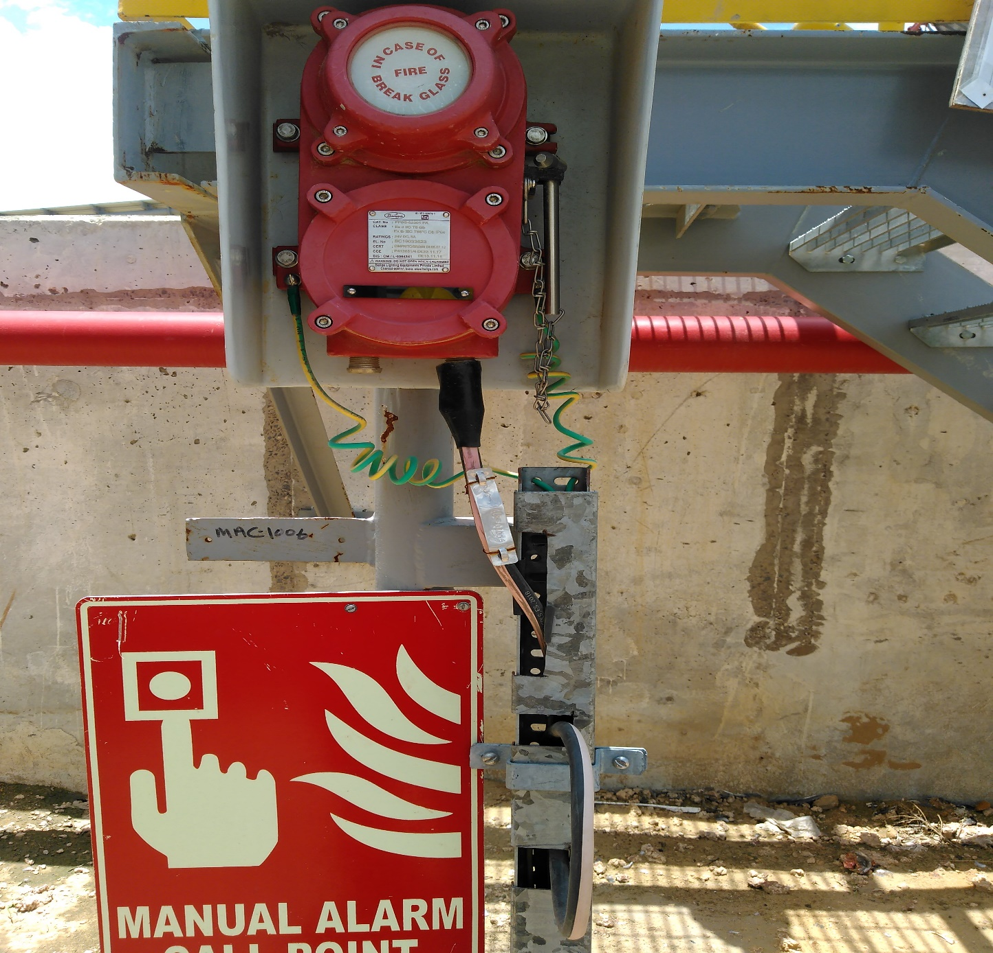
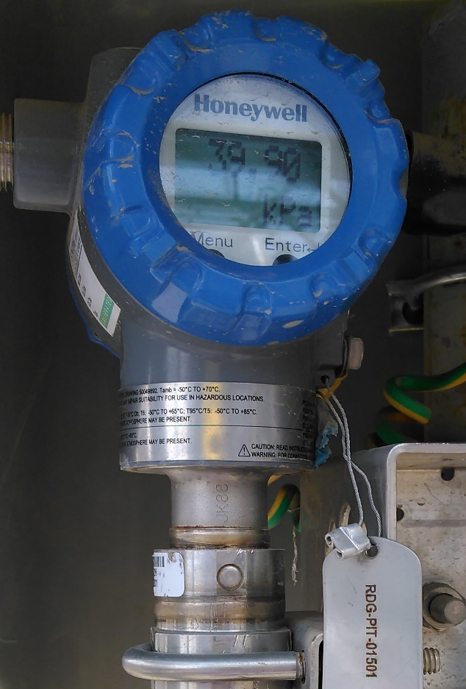
Instruments Ratings
Pressure Safety Indicator Transmitter (PSIT)
Ex d IIC T6 T5 Ga/Gb
Ex tb IIIC T95C Db
Level Indicating Transmitter (LIT)
II 1/2G Ex db in IIC T4 Ga/Gb
Manual Alarm Call Point (MAC)
Ex db IIC T6 Gb
Ex tb IIIC T85C Db
IP66
Pressure Indicator Transmitter (PIT)
Ex d IIC T6…T5 Ga/Gb
Ex tb IIIC T95C Db T6

Slide 31
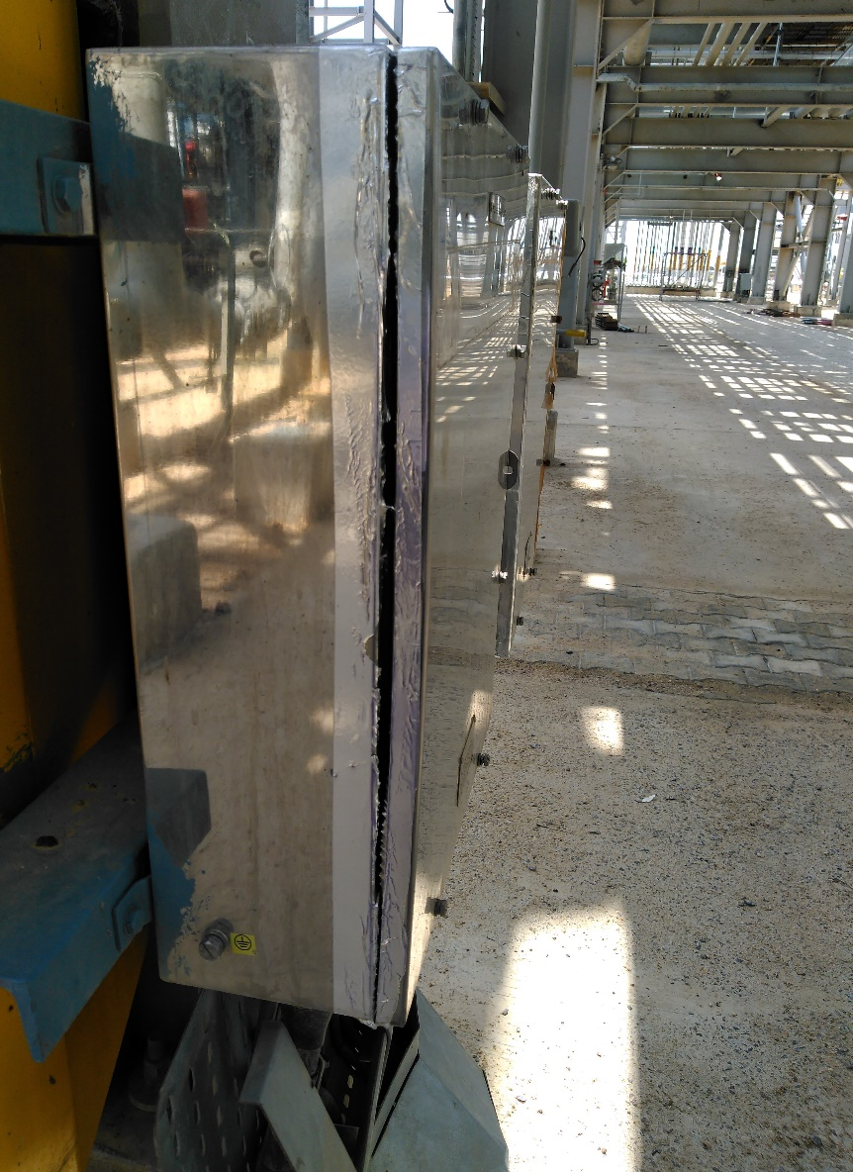
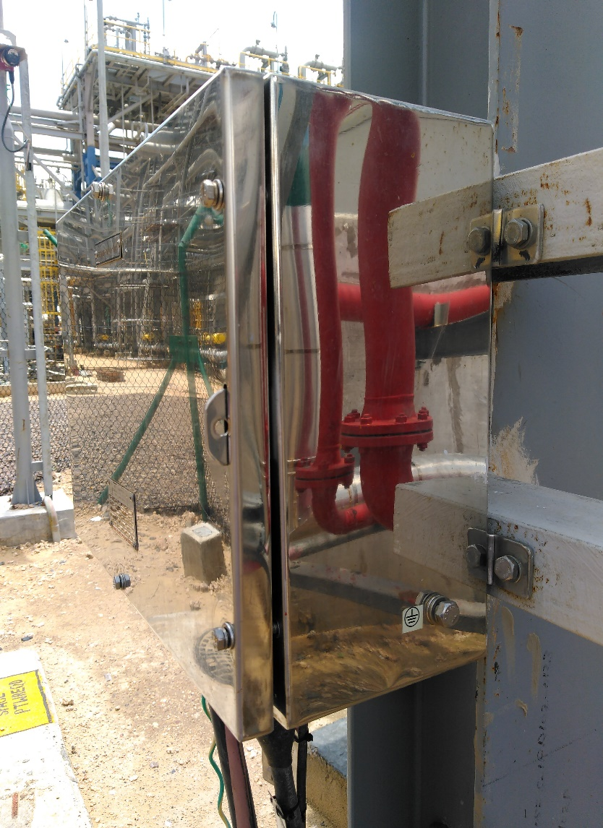
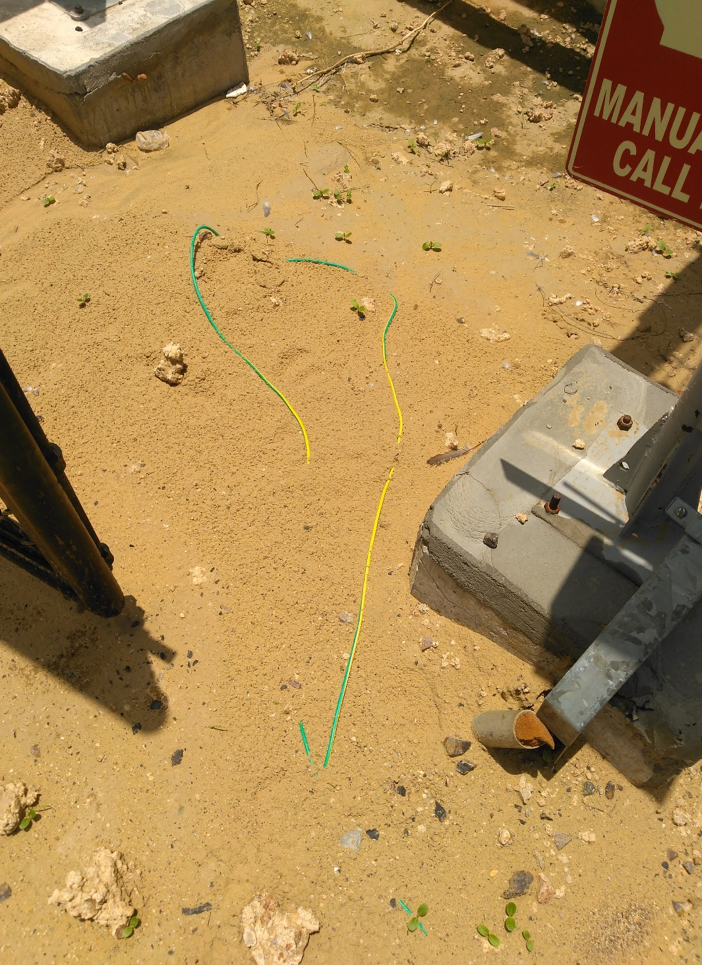
Scope of Improvement
Protection Covering Taping must be done properly after work
Taping not done at openings of protection covering of junction box
Wires must be buried underground with proper protection covering

Slide 32
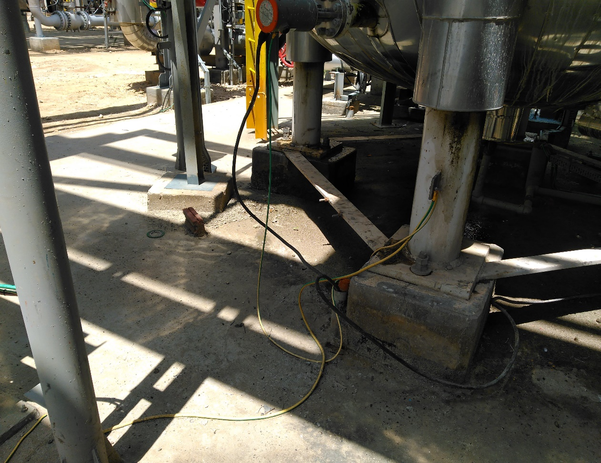
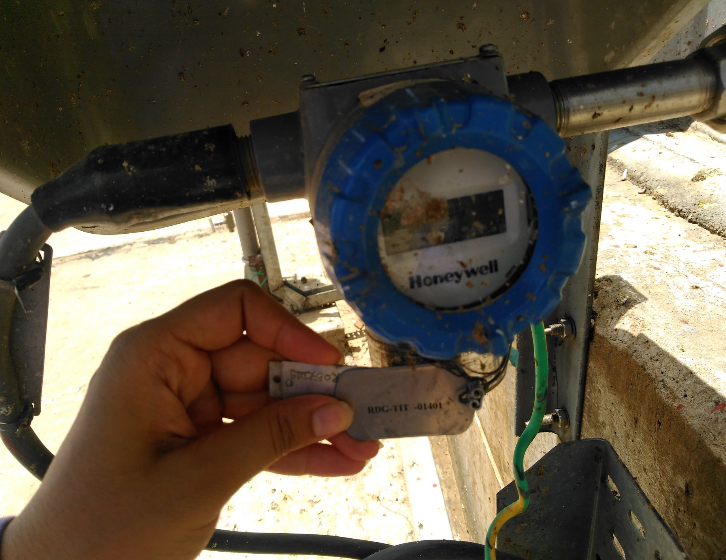
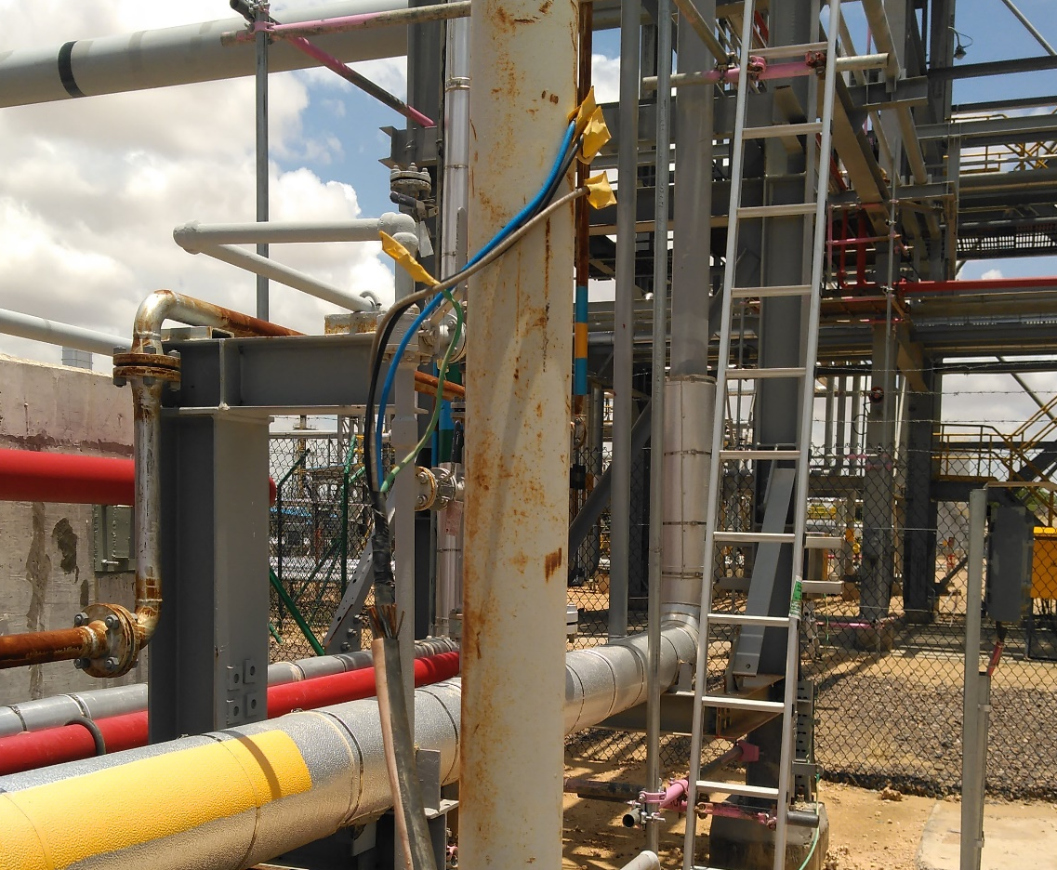
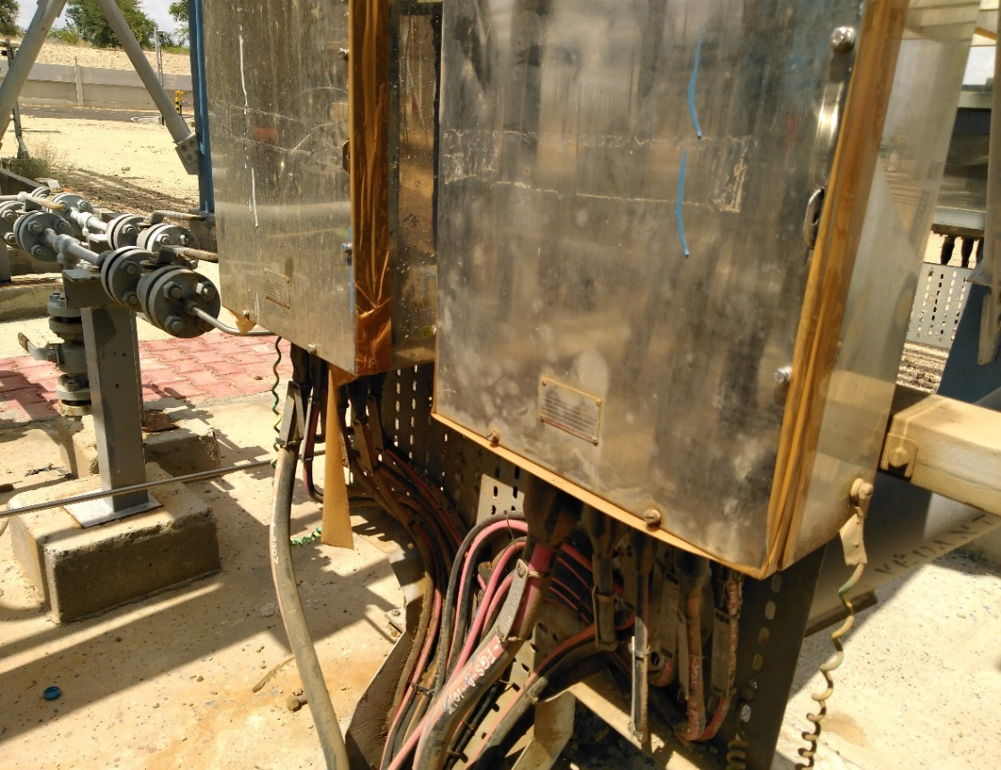
Wires should be appropriately fixed
Stray Wire must be properly placed
Instruments must be cleaned regularly
Taping not appropriate at openings

Slide 33
Conclusion
Checked the integrity of instruments as per hazard area classification.
Studied the ATEX and IECEX ratings of instruments in plant.
Checked the IP protection of instruments.
Studied Hazard area classification of plant.
Studied various protection techniques and method to avoid hazard.
Collected tag wise data of instruments installed in field and verified their rating according to hazard area classification.

Slide 34


